Slide 1
What’s and Why’s of SRE
Assisting our customers in their adoption of world-class SRE practice
NOT TO BE SHARED OUTSIDE NTT DATA

Slide 2

Why SRE maturity is Important
1
Reduction in Mean-Time-To-Repair:
SREs improve the reliability of production systems, and reducing MTTR is their top priority. As research shows that 60% of SREs spend most of their time building and maintaining automation code
.
62%
Deloitte SMEs believe
“SRE is about defining ‘reliability’ in terms of customer satisfaction and letting data drive the decisions.”
56%
System of Engagements implementation and 42% System of Record implementations by Google
SRE Principles help Improving 25% of production deployment cycles
Achieve stability and reduce incidents by 75%
2
Focus on Security:
More than two-thirds (nearly 70%) of SREs think that their role in security will become even more central in the coming future. This trend will increase if organizations use third-party libraries for cloud-native app development.
3
Freedom to Experiment:
Experimentation is critical to SRE. While more than half (52%) of SREs dedicate significant of time to designing experiments and tests to reduce the risk of production failure, only 1 in 10 highlights this as their top priority.
4
Shift to SRE-driven engineering
More than half (51%) of SREs dedicate significant time to influencing architectural design decisions to improve reliability. This suggests that organizations have made progress toward SRE-driven engineering across to improve reliability, resiliency, and security.
19% of organisation’s leverage SRE to specific teams for
55% of products and services
SRE Implementation Formula:
Anxiety = 1/Reliability (thereby leading to better customer feedback and client relationships)
5
Reliability - A growing priority:
SRE is expanding beyond just development roles, but with the new socio-technical definition of reliability, teams entirely outside engineering will prioritize it in their process and culture.
Notes:
Talk about genesis of SRE at Google

Slide 3

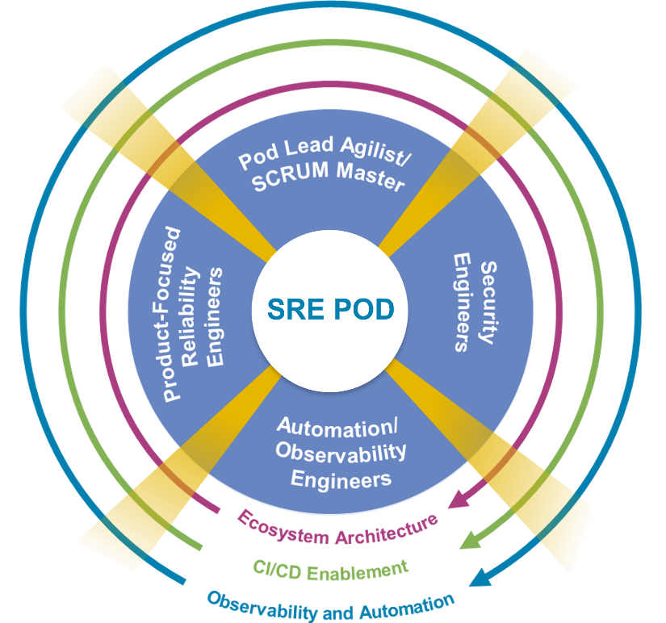



NTT’s Approach to Transformation Journey
context
Current State
Transformation State
Target State
Continuous improvement of SLI/SLO
SRE-as-a-Service with Continuous Improvement
SLI/SLO/EB
Automation
Meaningful dashboards
Enterprise Observability Automation
Data silos
Manual repeated
task
Undefined
thresholds
Feedback on SLO/SLI
Assess & Recommend
Continuous improvement of AIOps
Automation
AIOps
AIOps platform for SRE Operations
Feedback on AIOps
Reactive
Proactive
Predictive
Enterprising

Slide 4
How NTT DATA is helping customers in their Transformation Journey
SRE transformation follows a highly collaborative three-phased approach: Engage, Transform and Evolve
Engage
Evaluate observability platforms to monitor applications and analyse configured alerts
Assess implemented SRE metrics (SLI, SLO and error budget) and available dashboards
Evaluate current processes
Analyse team structure, capabilities and ways of working
Recommend data-backed improvements
Provide a clear “risk versus reward” matrix to prioritise recommendations
Implement proof of concepts (POC) for a selected set of recommendations
Create and provide a roadmap for strategic/ transformational programmes to implement recommendations.
Execute
Define/tweak SLI, SLO and error budget, KPIs on the observability tools
Implement a framework to encourage automation to reduce manual toil
Execute automation based on recommendations from the previous phase
Alert the optimisation
Administer real-time informative dashboards
Define/refine processes, procedures and others
Collect metrics data and baseline threshold
Conduct system and solution increment reviews
Evolve
Flexible NTT DATA SRE PODs plugged with the existing SRE teams to meet varied demand
Regular tweaking of alerts configurations
Regular automation implementation
Constant learning and development of Engineers
Continuation of alignment with value streams
Regular updates of hotspots to various stakeholders
Regular upskilling of the team
Provide day-to-day XLA-based ecosystem support
Outcome/capacity/demand services model ​
Administration support for the technology stack and DevOps toolset
Recommendations via risk-reward matrix
Proof of concepts (POC) for a select set of recommendations
Defined SRE metrics and dashboards
Refine/define SRE processes
Implement automation
Standard operating procedures
Continuous improvements
Flexible NTT DATA SRE PODs plugged in with core customer SRE global teams

Slide 5
Our strategy for tech-resiliency that aligns with our customer’s vision for improving CX/UX​

Slide 6






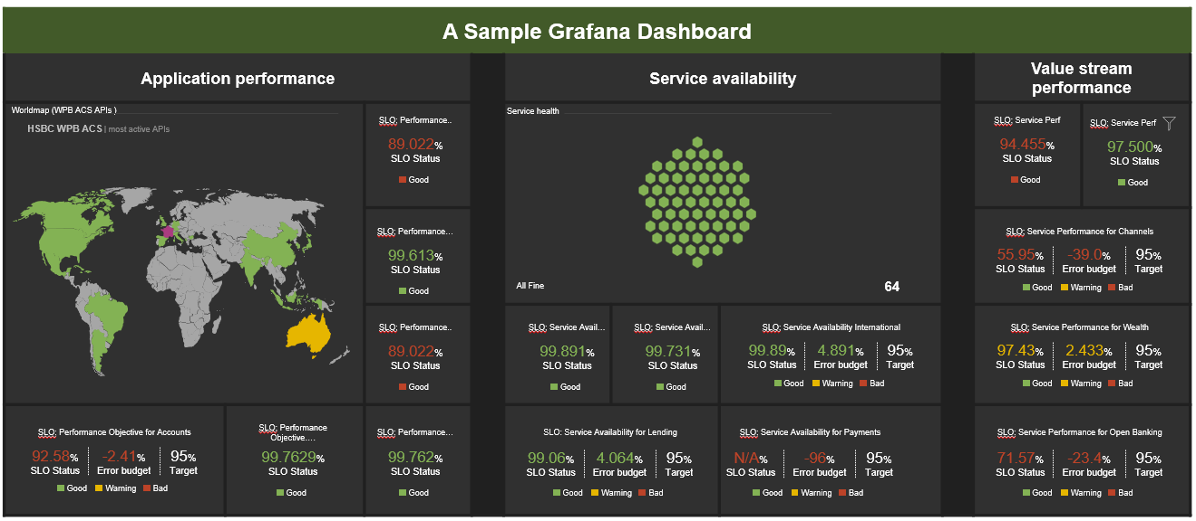
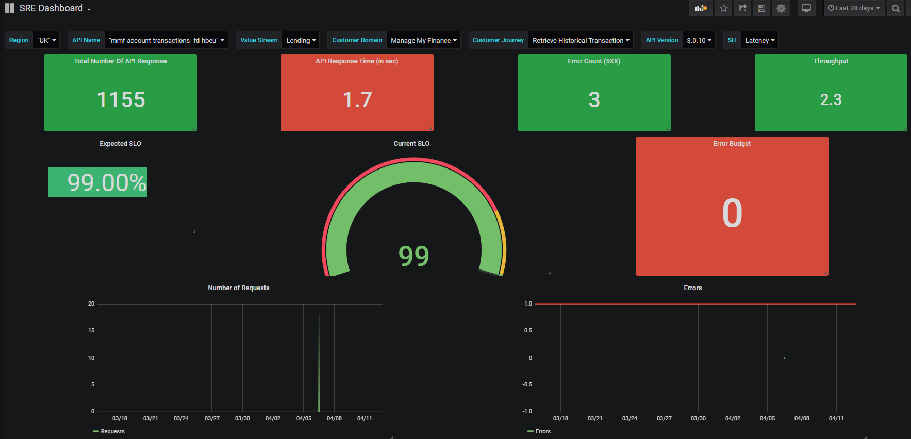



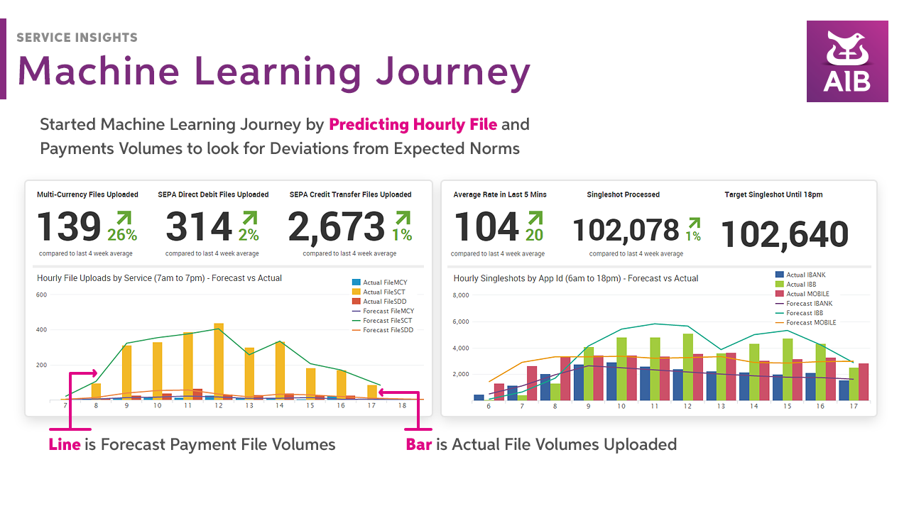
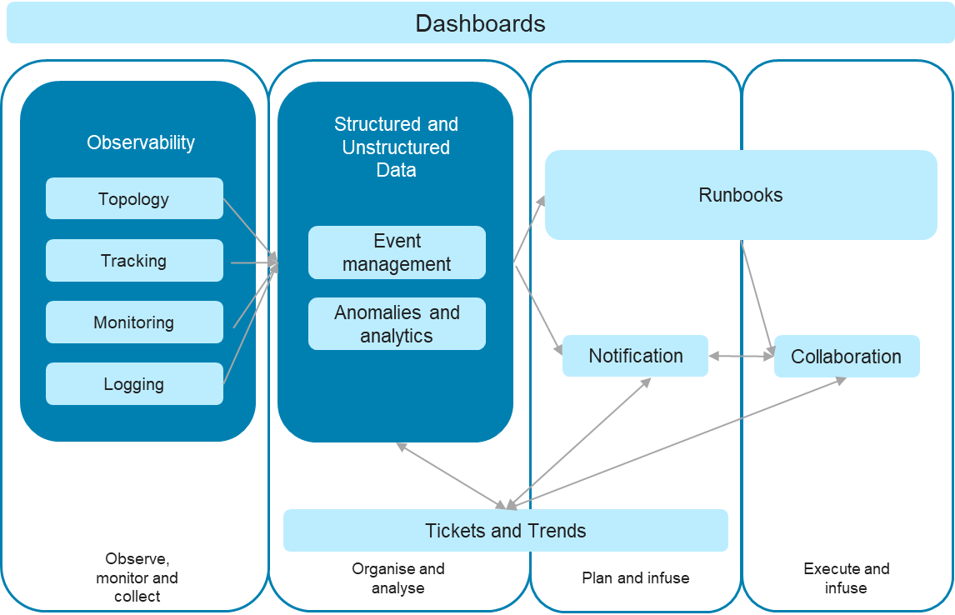
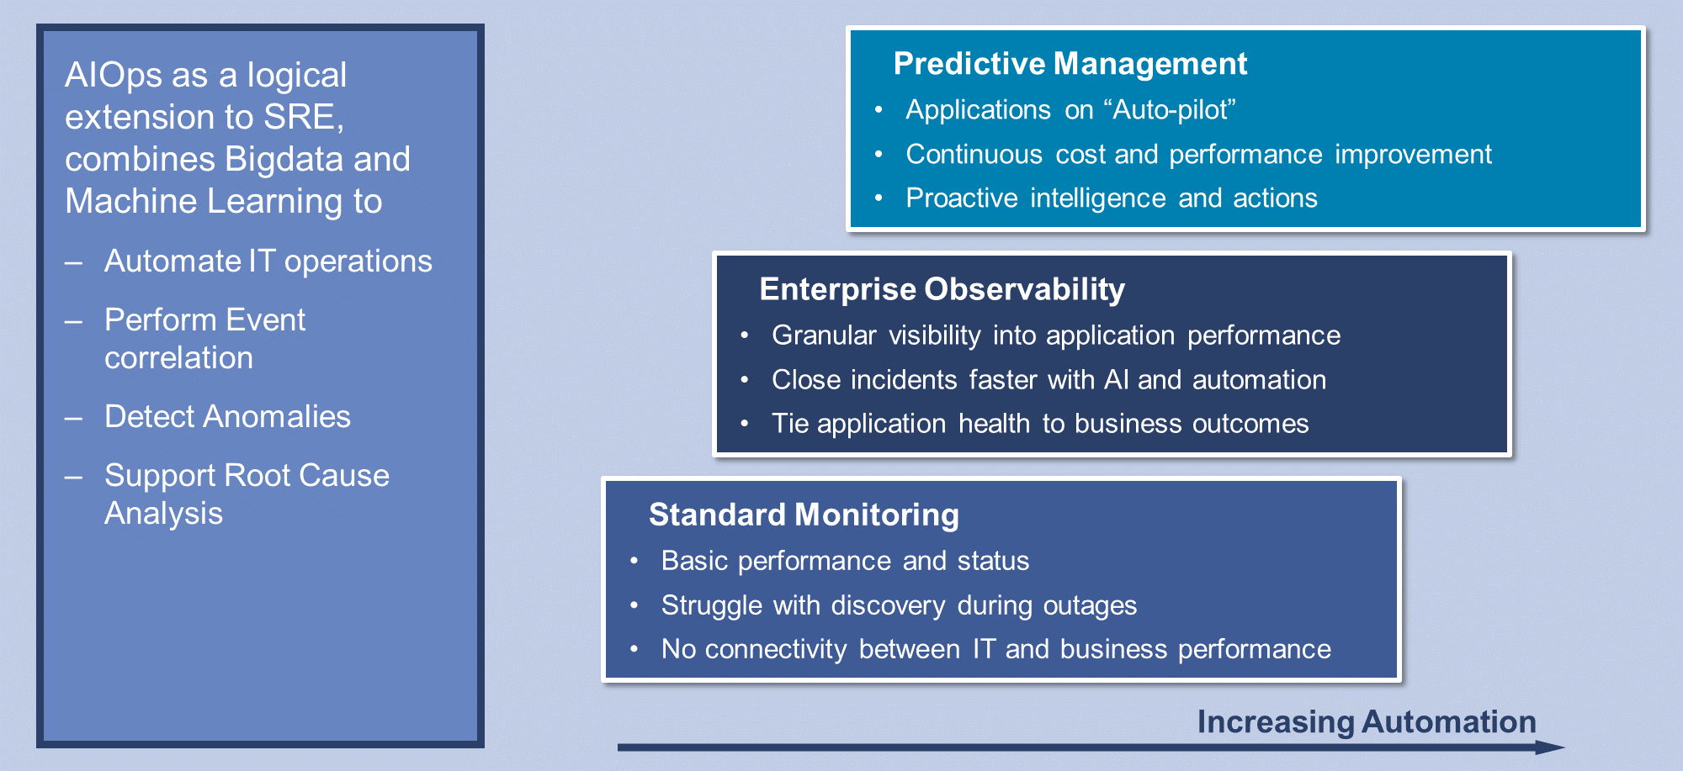
Illustrative Current & Proposed State – SRE Capabilities
Current State
Target State
Efficient Tools Configuration & Monitoring
Correlation of Data
Centralised Platform
Telemetry and Management Layer
Relational DB
NoSQL
Timeseries DB
Data collated from all the monitoring sources to use in Dashboards and feed to ML Algos in customer’s choice of AIOps toolset
Infra Monitoring
Apps Monitoring
ITSM Tool
Other tools (Cert Renewal)
Unified Dashboards
User/ Persona Layer
Clear path and correlation between payment transaction failure and customer impact through Single pane of glass using SRE principles (SLI, SLO, Error Budgets)
Observability
Business Users
Infra Layer
App Layer
Engineering
VM/CMS
Cloud
Microservices
Monoliths
SRE
Bespoke Automation
Actual use case shall be decided post current state assessment. Possible examples – Runbook automation, Certificate renewal, Configuration as a code
Networks
Bare metal
Serverless
Mainframe
Use Case 1
Use Case 2
Use Case 3
Use Case n
Reactive approach to Site Reliability Engineering
Inefficient implementation of monitoring tools – too many false-positives
No single observability platform
Historical alerts & incident data not available as rich monitoring data not shared outside monitoring tools and is discarded within a few weeks.
Undefined automation strategy. Lack of engineering mindset.
Data Analytics
Historical Trend Analytics
Future Projections
Failure Hotspots Identification
AIOps
Self-healing
Predictive Maintenance

Slide 7


Bringing it to life - The “how” of the strategy
“CHAPS High-value Payment” Customer Journey
Channels VS
Wholesale Payments VS
Wholesale Payments VS
Wholesale Payments VS
Enterprise-Tech VS
Online App
Payments Online
Payments Interface
Sanctions
Core Banking Hub
Build
Application
Network
Infrastructure
Middleware
Compute
Microservices App
Network
GCP
Middleware
Compute
C++ based App
Network
Unix
Middleware
Compute
Third-party apps
Network
Infrastructure
Middleware
Compute
AS 400 Mainframe
Network
I-Series Mainframe
Middleware
Compute
Establish SLOs
Define Signaling Standards
Tech Stack
Tech Stack
Tech Stack
Tech Stack
Tech Stack
Normalize Telemetry Data
Recommend for missing Telemetry
SRE Squad 1
SRE Squad 2
SRE Squad 3
SRE Squad 4
SRE Squad 5
Output
Integrated Signaling into SLIs
E2E tracing across journeys
Detailed Telemetry to support drill-down
Consumed by
Automation
Blameless Postmortem
SRE Team
Communication
Fault Isolation

Slide 8


Dashboards
Define and implement the dashboard for each API related to SLO and Error Budgets defined in 1.1.
A Sample Grafana Dashboard
Application performance |  |  |  | Service availability |  |  |  | Value stream performance
Worldmap (Value Stream APIs )
SLO: Performance..
Service health
SLO: Service Perf
SLO: Service Perf
Customer Value Stream | most active APIs
89.022%
SLO Status
94.455%
SLO Status
97.500%
SLO Status
A global view of the most active Application
Good
Good
Good
SLO: Performance…
SLO: Service Performance for Channels
99.613%
SLO Status
55.95%
SLO Status
-39.0%
Error budget
95%
Target
Good
All Fine
64
Good
Warning
Bad
SLO: Performance..
SLO: Service Avail…
SLO: Service Avail…
SLO: Service Availability International
SLO: Service Performance for Wealth
89.022%
SLO Status
99.891%
SLO Status
99.731%
SLO Status
99.89%
SLO Status
4.891%
Error budget
95%
Target
97.43%
SLO Status
2.433%
Error budget
95%
Target
Good
Good
Good
Good
Warning
Bad
Good
Warning
Bad
SLO: Performance Objective for Accounts
SLO: Performance Objective….
SLO: Performance…
SLO: Service Availability for Lending
SLO: Service Availability for Payments
SLO: Service Performance for Open Banking
92.58%
SLO Status
-2.41%
Error budget
95%
Target
99.7629%
SLO Status
99.762%
SLO Status
99.06%
SLO Status
4.064%
Error budget
95%
Target
N/A%
SLO Status
-96%
Error budget
95%
Target
71.57%
SLO Status
-23.4%
Error budget
95%
Target
Good
Warning
Bad
Good
Good
Good
Warning
Bad
Good
Warning
Bad
Good
Warning
Bad
Represents the defined SLO for a value stream
Represents the Error Budget left before it can impact the service
The error budget dashboard will help PM and team in identifying whether the API needs some attention like fixing it (depleted error budget) or it can handle more frequent feature releases
The SLO dashboard will help SRE in identifying, whether the API has a high impact (for example, an SLO of 99.999) and alert/incident related to it, is of the highest priority and need to fix it first
Notes:
Speaker: Vikram
Mark and Aleks can use these dashboards without any intervention of any of the SRE team members. They can use this to provide data backed information to senior stakeholders.

Slide 9
Our current resiliency engagements in HSBC

Slide 10
NTT DATA’s SRE engagements with HSBC – 2022 till date
WPB Application Core Services
Wholesale GPS
Got embedded in the existing SRE team
Assessed the team on their technical knowledge and fitness to become SRE
Identified areas of inefficiencies
Using our Risk/Reward Matrix every inefficiency identified was paired with a recommendation and its relevant impact basis its value parameters and risk parameters
Demonstrated how to implement recommendations
Walked the talk by showcasing POCs for many of the recommendations identified as part of the engagement.
All the things we did in WPB plus -
Created a standard framework for Splunk and AppD monitoring configurations
Implemented dashboards that were of practical use to various teams within GPS
Conducted Show+Tell sessions as partners with the bank
Every show+tell session we conducted, NTT and HSBC presented as partners that showcased our approach to every engagement we are awarded.
May 2022 to Dec 2023
Oct 2023 – ongoing
SRE Culture + People Assessment + Coaching
Engagements
Customer Impact Centre for UK IBS
A central SRE team to own the creation of full-stack observability
Starting from customer journey maps to service chain maps and every layer of technology component that enables a customer journey.
Identifying gaps in the Logs, Traces and Metrices for each component.
Providing recommendations to fix those gaps
Creating a clear path to implementing SPOG dashboards customer journey by customer journey, enabling better MTTR/MTTD/MTBF, etc.
NTT is conducting an assessment for a small subset of WPB IT function.
Cultural assessment using tweaked OCI framework
128 questions were designed to assess the culture within the team.
Technical assessment of the teams
From SREs, operations teams, programme managers and leaders. Everyone was assessed on their understanding of SRE
Recommendations to fix the gaps identified
Sep 2023 – ongoing
Proposal Submitted

Slide 11
“Talk is cheap. Show me the code.”
Linus Torvalds

Slide 12
WPBREC06 - Logging should be part of the acceptance criteria

Slide 13
Recommendation Details
Proposed Recommendation | Proposed Recommendation Description | Issue Targeted | Impacted Area | Impacted Systems/Tools | Impacted Team
Logging should be part of the acceptance criteria | 1. Common logging standard to be followed at organisation level 2. Logs should be query-able and make use of key-value pair 3. Log message should be meaningful 4. Avoid unwanted logging 5. In case of error, provide as much as possible information e.g. service_name, logged_user, correlation_id, method_name, call_stack, http_code, utc_time 6. Use common field name throughout the system | 1. Unwanted logging in Splunk leading to potential increase in Splunk cost 2. Due to coding standards not being followed uniformly for writing logs, much longer time is required to troubleshoot the problems 3. Unnecessary knowledge transfer and documentation is required to understand the logs | Technology | Splunk | Dev Team
Comments/Benefits
Faster investigation of problems Easier troubleshooting Operation and monitoring systems can ingest data easily without any data transformation When writing logs to log files, log message output should be tested in Splunk (Splunk testing should be part of acceptance criteria)
Reward Ranking | Risk Ranking | Strategic Roadmap Ranking
22.16 | 8.91 | 2.49

Slide 14
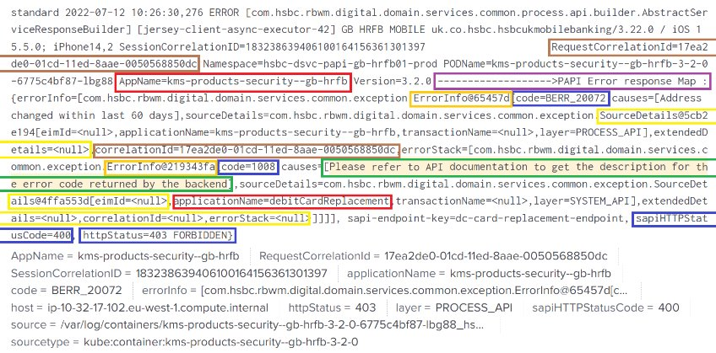
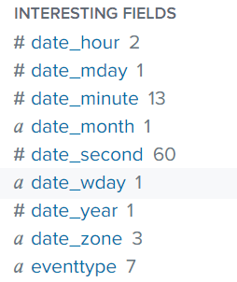
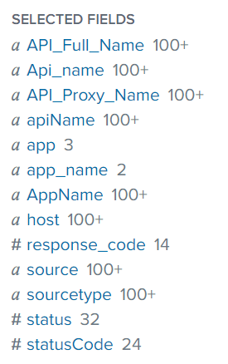
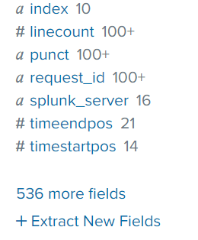
Example of inefficiency in engineering - Logging standards are not followed
When we search logs with an apps Monitoring Tool query index=digital_*
The result should display meaningful fields, but in reality there are around 500 fields; many of them can be avoided by writing better logs. Additional fields will unnecessarily eat up support team’s time to analyse the logs.
When we search logs with Monitoring tool query index=digital_* | transaction ReqCorrelationId maxspan=30s
Result of this query should display each completed or failed transactions in a group of events for that correlation id.
But in reality multiple correlation ids are used:
correlationId
Jwt correlation Id
Session Correlation ID
Request correlation id
X-Customer-Session-Correlation-Id for SESSION_TOKEN
X-Customer-Session-Correlation-Id for ACCESS_TOKEN
X-Customer-Request-Correlation-Id

Slide 15
WPBREC09 - Splunk Search Improvement - DIGITAL SERVICE HK SAPI 5XX Email ALERT

Slide 16
Recommendation Details
Proposed Recommendation | Proposed Recommendation Description | Issue Targeted | Impacted Area | Impacted Systems/Tools | Impacted Team
Splunk Search Improvement - DIGITAL SERVICE HK SAPI 5XX Email ALERT | New search query save approx 25 sec. (20% reduction in time to execute) Details of the change described in the next slide | Splunk performance | Standards | Splunk | SRE Team
Comments/Benefits
Best Practice
Reward Ranking | Risk Ranking | Strategic Roadmap Ranking
10.37 | 3.24 | 9.5

Slide 17
Existing Search Query: sourcetype=technical_pcf_app_proc_web* (index=digital_technical_pcf* OR index= digital_technical_authz_bsplus_raw OR index= digital_technical_sapi_bsplus_raw) |rex field=_raw "\s(?<sapi_dc>[\wd]+)(ko100|km100|ko101|km101)-(?<sapi_org>[\w\d-]*)\.(?<sapi_space>[\w\d-]+)\.(?<sapi_app>[\w\d-]+)\s" |search HTTPStatusCode>= 499 |eval series=1 |fillnull value=NULL |stats count(HTTPStatusCode) as status5xx values(MainframeErrorCode) as ErrorCode perc95(TotalSAPIResponseTime) as p95ResponseTime by APP_Name HTTPStatusCode |where status5xx >=25 New Search Query: (index=digital_technical_pcf* OR index= digital_technical_authz_bsplus_raw OR index= digital_technical_sapi_bsplus_raw) sourcetype=technical_pcf_app_proc_web* HTTPStatusCode>= 499 |fillnull value=NULL |stats count(HTTPStatusCode) as status5xx values(MainframeErrorCode) as ErrorCode perc95(TotalSAPIResponseTime) as p95ResponseTime by APP_Name HTTPStatusCode |where status5xx >=25
Change: • No use of regex & series in search string – we can remove this o |rex field=_raw "\s(?<sapi_dc>[\wd]+)(ko100|km100|ko101|km101)-(?<sapi_org>[\w\d-]*)\.(?<sapi_space>[\w\d-]+)\.(?<sapi_app>[\w\d-]+)\s" o |eval series=1 • Wrong placement of HTTPStatusCode>= 499, this should be part of main search

Slide 18
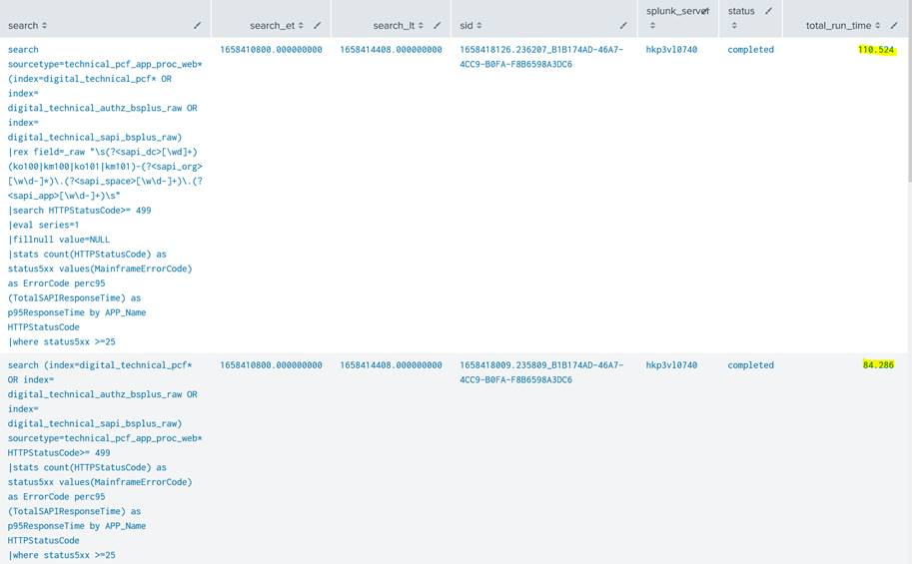

Slide 19
WPBREC23 – End-to-End Certificate Auto-renewal - PART 2

Slide 20
Recommendation Details
Proposed Recommendation | Proposed Recommendation Description | Issue Targeted | Impacted Area | Impacted Systems/Tools | Impacted Team
Certificate Auto-renewal - PART 2 | This is part 2 of the WPBREC20 that automates the runbook where end-to-end certificate renewal and push into microservices steps take place. | Manual Cert renewals to be automated. | Enhance | Technology | Security
Comments/Benefits
By our rough calculations, today the team approximately undertakes >2000 cert renewals every year (sometimes one renewals processes includes more than 1 cert) and each renewal requires roughly 60 minutes each time. This means the SRE team spends roughly 120000 minutes every year on just cert renewal which equates to 1.13 FTE per year. This automation will free up that much team time to focus on innovation and further automation.
Reward Ranking | Risk Ranking | Strategic Roadmap Ranking
26.37 | 10.395 | 19

Slide 21










End-to-End Cert Renewal Automation POC Architecture – Supplement to WPBREC20
Webhook Triggered on Code Check-in
DNS
VPC (Bare metal)
Internet
Minikube K8s Cluster
https://jenkins.traderyolo.com
Mem-Leak-Java Namespace
GIT Repo
NGINX (Reverse Proxy)
Problem App
Venafi Cert Renewal App
Vault
POD
Spring Boot Cert App
Restart Pod Command
github.wiqram.splunk-hsbc-demo
Jenkins Namespace
xMatters
Internet
POD
Redeploy app with new cert and key
Trusted Certificate
Jenkins
Access K8s cluster resources over NodePort OR LoadBalancer
POD
Deploy Config & Refresh Pods
Deploy Agents
XAgent Namespace
xMatters Workflow
Xmatters Free Trial
XAgent
xMatters Alert
Venafi
https://splunk.traderyolo.com
Splunk Namespace
All Pods within Namespace can only access Pods across cluster based on their associated and tagged Service Accounts and access given to those SAs
Splunk
Cert store
Certificate Issuing Authority
Splunk-Connect Namespace
POD
Metrics
Logs
Snyk
Data Collectors
Vulnerability Check
Security check
LetsEncrypt CA
Pushing changes to git
Renew and downloading Cert

Slide 22
WPBREC20 – Certificate Auto-renewal – Part 1

Slide 23
Recommendation Details
Proposed Recommendation | Proposed Recommendation Description | Issue Targeted | Impacted Area | Impacted Systems/Tools | Impacted Team
Certificate Auto-renewal - PART 1 | HSBC currently has Venafi that manages the certificate renewals manually. We want to automate that to ensure some of the alerts caused by out of date certificates don’t occur again. This is divided into 2 parts - 1) where certificates are automatically renewed and 2) the renewed certificates are injected into relevant microservices and deployed | Manual Cert renewals to be automated. | Enhance | Technology | Security
Comments/Benefits
Reduces outages caused by out of date certificates.
Reward Ranking | Risk Ranking | Strategic Roadmap Ranking
36.29 | 4.68 | 1.5

Slide 24
End-to-End Cert Renewal Automation POC Architecture – PART 1
Webhook Triggered on Code Check-in
DNS
VPC (Bare metal)
Minikube K8s Cluster
Internet
https://jenkins.traderyolo.com
Venafi namespace
Mem-Leak-Java Namespace
NGINX (Reverse Proxy)
Problem App
GIT Repo
Python Script Micro
POD
Jenkins Namespace
Restart Pod Command
Internet
github.wiqram.splunk-hsbc-demo
POD
Trusted Certificate
Jenkins
XMatter
Access K8s cluster resources over NodePort OR LoadBalancer
XAgent Namespace
Deploy Config & Refresh Pods
XAgent
Deploy Agents
Xmatter Workflow
Xmatter Free Trial
Splunk Namespace
Xmatter Alert
Venafi
Splunk
https://splunk.traderyolo.com
Splunk-Connect Namespace
POD
All Pods within Namespace can only access Pods across cluster based on their associated and tagged Service Accounts and access given to those SAs
Metrics
Logs
Certificate Issuing Authority
Cert store
Data Collectors
Snyk
LetsEncrypt CA
Vulnerability
Check
Security check

Slide 25
But – “Culture eats strategy for breakfast”
Peter Drucker

Slide 26
Culture Assessment

Slide 27




How our Assessment was Structured
We conducted a timed data collection activity from the representatives within the value-stream, wherein they were asked to give unfiltered responses to 128 questions
1
Competitive: Aggressive-Defensive Styles
Conservative: Passive-Defensive Styles
Growth Oriented: Constructive Style
2
The assessment sought to evaluate the organization’s culture, specifically in relation to SRE Psychological Safety and Blameless Postmortems and categorize the resulting behaviors into the 3 overarching behavioral styles. Each question included two dimensions (with a cluster of thematic areas)
3
The two dimensions that make the scoring methodology are layered such that the behavioral themes are captured across the sub-value stream and enable building of a representative picture of the organization’s culture and its alignment to the SRE culture
Implementation of Blameless Postmortems
An environment of psychological safety
Culture of continuous improvement & innovation
THE 5 SRE-INCLINED THEMES
A
Elements of a Constructive Postmortem
Meaningful improvements enhancing reliability
Behavioral Styles | 12 Thematic Areas | 128 Questions
Competitive: Aggressive-Defensive Styles | Challenging, Authority Centered, Performance Driven, Perfectionism | 40 questions
Conservative: Passive-Defensive Styles | Cautious, Reliant, Traditional, Approval-seeking | 44 questions
Growth Oriented: Constructive Style | Goal-driven, Self-development, Supporting, Collaborative | 44 questions
THE 12 ORGANIZATIONAL STYLE THEMES
B
A deeper glance into the thematic areas under the core behavioral styles provide a cluster of homologous behaviour-patterns of people, which thus translates into the Psychological Safety Assessment
Notes:
Having established the context of Enablement within SRE, I will now take a couple of minutes to explain the structure of the assessment.
We used a two-dimensional approach, assessing the organization across 128 questions designed to measure both cultural behaviors and specific SRE-related themes.
The first dimension is grounded in the Organizational Culture Inventory (OCI), which categorizes behaviors into three distinct styles: Constructive, Conservative, and Competitive. Under each style, we explored four thematic areas.
The second dimension was tailored to SRE principles—psychological safety, blameless postmortems, and collaboration. This gave us 64 variables to assess, and allowed us to align our cultural analysis with the key tenets needed to adopt and scale SRE practices across HSBC.
Durvesh, would you like to add something regarding the structure of our assessment.

Slide 28
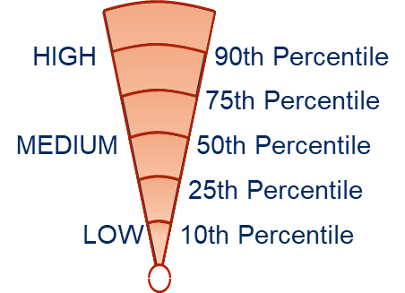

How does an organization’s culture in the context of SRE Enablement looks like?
Predominant behaviour could be somewhere between Conservative, Competitive or Conservative
Key Observations
Scores (out of 10)
Competitive: Aggressive-Defensive Styles
Loyalty and unquestionable adherence to top management’s decision is expected from the team.
Habit of working in a closed group prevails with controlling power in the hands of just a top few.
High pressure environment to deliver outcomes and expectations which results in a latent Authority-Centered competitive culture.
Challenging | 5.6
Authority Centered | 7.6
Performance Driven | 6.8
Perfectionism | 6.4
Task Orientation
Satisfaction Needs
Growth Oriented: Constructive Style
Perfectionism
Goal Driven
Competitive: Aggressive-Defensive Styles
Performance
Driven
Self-
Development
Authority
Centered
Supportive
Conservative: Passive-Defensive Styles
Traditional ways of working are dominant leading to preference towards established norms, approaches and rules.
Feeling of potential criticism guides individual’s actions, requiring them to seek approval before every decision.
Strong dependence is there on team leaders, absence to which leads to anxiety among team members.
Approval Seeking | 8
Traditional | 9.2
Reliant | 7.4
Cautious | 5.6
Challenging
Collaborative
Conservative: Passive-Defensive Styles
Cautious
Approval
Seeking
Growth Oriented: Constructive Style
Reliant
Traditional
Strong focus on meeting personal & organizational goals with a sense of accountability. (This behavior also stems from a competitive environment)
Willingness for developing new skills and grasp opportunities.
Individuals are supportive, however will not go out of their way to help.
In situations of issues, individual accountability is considered very important to resolving them.
Goal Driven | 7.4
Self-Development | 6.4
Supportive | 4
Collaborative | 6.4
Security Needs
People Orientation
OCI circumplex from Robert A. Cooke and J. Clayton Lafferty, Organizational Culture Inventory®, Human Synergistics International. Copyright © 1987-2009. All rights reserved. Used by permission.
Note: None of these traits are “good or bad” in themselves. Keeping in view that we are focusing on the behavioral traits that enable SRE Principles – scoring high on Competitive shows misalignment to SRE ways of working & a Growth-Oriented high score is ideal for SRE. Being a global bank, scoring high on Conservative is expected.
Notes:
Having investigated the 64 variables and the responses we received – we collated the latent behavioral traits most prevalent within the Value stream in HSBC.
Given that, the business context is a Bank, it was not surprising that the predominant behavior is Conservative.
Bear in mind, none of these traits are “good or bad” in themselves. Keeping in view that we are focusing on the behavioral traits that enable SRE Principles, we would like to draw attention to certain characteristics…
Key observations :
[Constructive] We found several pockets of growth-oriented behaviors, that support SRE Principles. Goal-Driven; keen to collaborate…
[Constructive] Supportive and Collaboration areas were found to be less prominent – which points to silo-ed area of focus … only looking at a limited Operations view, not wholistic areas …
[Constructive] While there is a strong desire to learn, develop skills, the focus is more on individual areas.
[Competitive] There is a latent dominance of authority-centered, performance-driven, and perfectionistic traits.
[Competitive] This has unintended consequences, such as limiting innovation, individuals are under heavy pressure to focus on their individual component of the ecosystem – driving “silo” mindsets.
[Competitive] Indicators pointing to psychological safety and promoting blameless postmortems were found to be short in supply.
[Conservative] “fear of failure” Indicators were found amongst the responses from the team members – there was a tendency to find comfort in approvals and reliance on traditional hierarchies.
[Conservative] narrow-concentrated decision-making has the consequence of limiting proactive problem-solving.
I will take you through the first segment… and then I will request Prashita and Tanvi to cover the other two segments…

Slide 29
Technical Assessment

Slide 30






Building Blocks of the Data Collection Activity for SRE Maturity
Team Members Readiness
Product Owners Readiness
~46 questions were asked to 23 candidates to capture the capability & depth of understanding of SRE concepts in alignment to the business unit
Product Owner interviews were conducted to assess general SRE knowledge and thoughts with 2 Product Owners on acceptance of SRE ways of doing Business
Questions are grouped around 11 themes for an in-depth analysis:
General SRE Concepts
Reliability & Availability
Incident Management
Monitoring & Alerting
Application Tracing
Automation & Scalability
Tools & Technologies
Logging
Security and Compliance
SRE Practices and Culture
24 Questions were asked with aggressive follow-ups to gain an understanding of Product-Owner perception on:
General Understanding and Awareness
SLO’s and SLI’s
Error Budgets
Toil Reduction and Automation
Emergency Response and Incident Management
Collaboration and Culture
Support for Reliability Goals
Long Term Vision & Strategy
Feedback & Improvement
ANALYSIS
Scoring of Responses:
1: Did not know the answer
2: Partially knew the answer
3: Mostly knew the answer
4: Knew the answer
Understanding Covariants:
Covariants were examined to understand the quality of single questions in a dimension and how a poorly crafted question could affect the average score.

Slide 31

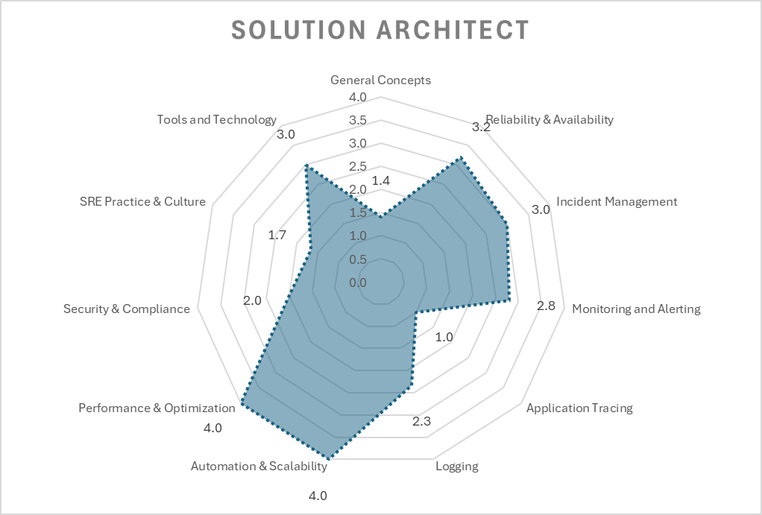
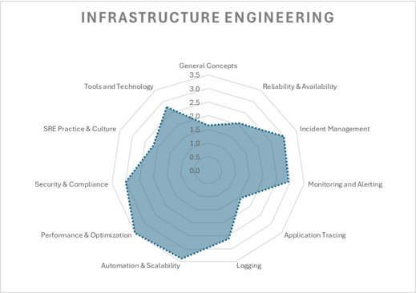
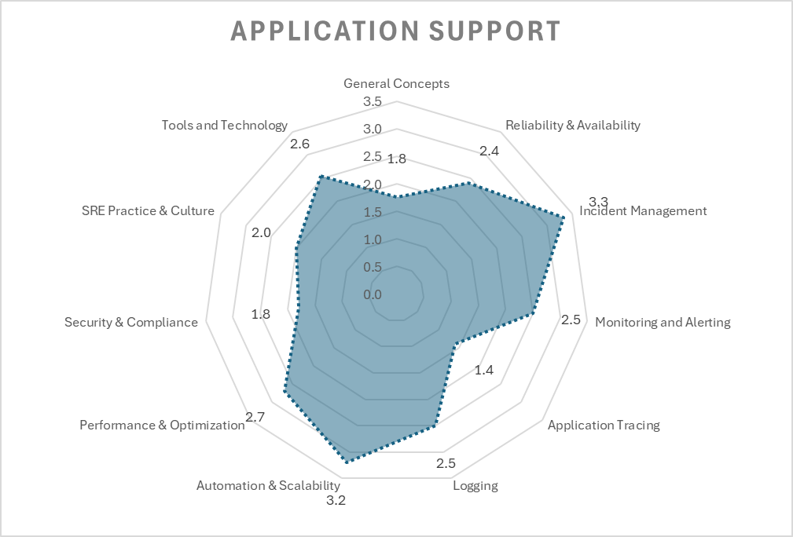
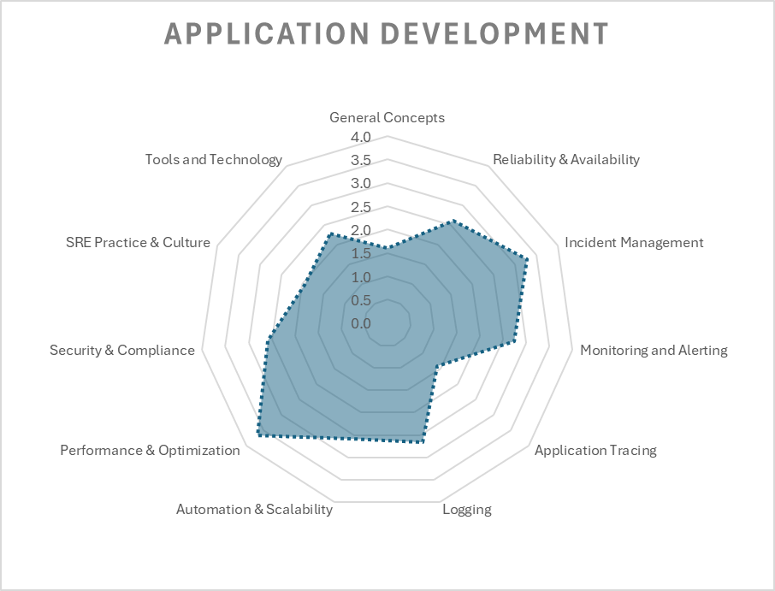
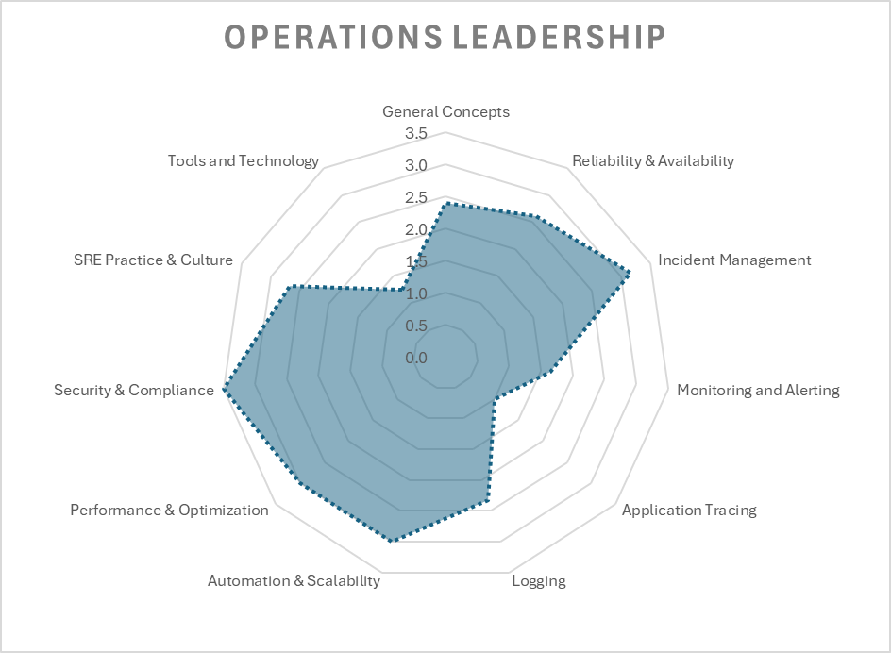
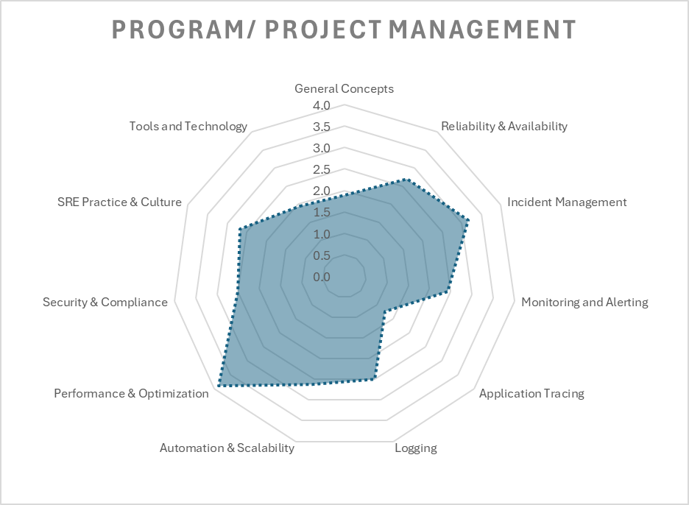
Radar Charts of SRE Questions: by Dimension
Observations of grouped results display similar patterns of strengths and weakness, although certain
strengths and weaknesses may be amplified based on the target group

Slide 32
NTT Accelerators – Helping our organisations embrace the SRE practice quicker

Slide 33
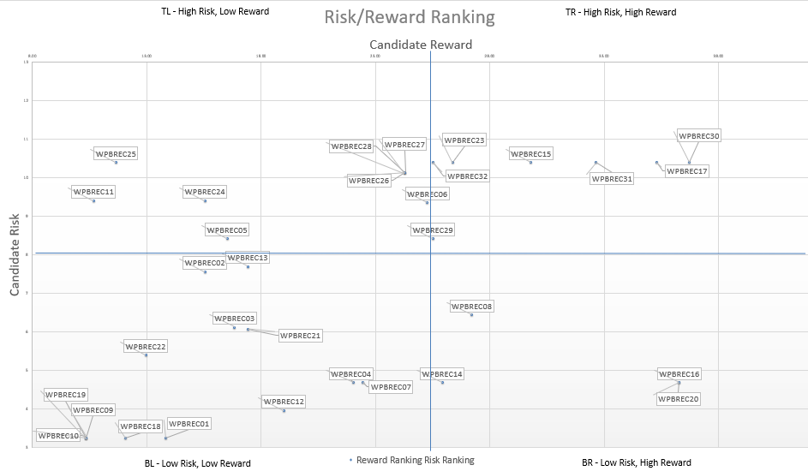

NTT DATA’s SRE Accelerators
Risk – Reward Matrix
Baseline SRE Metrics
SLI, SLO and Error Budget are crucial components of SRE. They help quantify the performance and reliability of services and set expectations for users and stakeholders. We have defined templates for the metrics (VALET) that can be used for a quick baseline setup.
V=Volume;
A=Availability;
L=Latency;
E=Errors;
T=Tickets
Accelerators
Quick Win Automations
SPoG & Integration
Splunk Configuration Changes
Pipeline that can be integrated to enable a configuration-as-code approach for managing Splunk settings. This streamlines the process of updating and maintaining Splunk configurations.
Certificate Renewal –
Microservice that automates the renewal of certificates hosted on Venafi. The service ensures the timely renewal of certificates and automatically pushes updated certificates to the relevant application repositories.
And Many More…
Single Plane of Glass
Comprehensive observability strategy is necessary for effective SRE. We have predefined dashboards in Grafana (an open-source tool) for SRE that can be reused by importing JSON files
Integration Scripts
We have developed tool-agnostic Python scripts that facilitate connections to various sources, such as Splunk, AppDynamics, InfluxDB, and more, enabling the retrieval of key application performance metrics and data transmission to databases.

Slide 34
Industry Standard Metrics for Measuring the Effectiveness of an entire IT Estate
Business Channel
Average lead time (ALT) | Work-in-progress (WIP) | Percentage change user volume (CUV) | Average process time (APT) | Average wait time (AWT) | Mean time to restore (MTTR)
Development Channel
Test coverage percentage (TCP) | API reuse rate (ARR) | API consumption rate (ACR) | Build failure frequency (BFF) | Rework rate (RR) | Commit to prod deployment latency time
Build duration (BD) | Build frequency (BF) | Defects volume (DV) | Code analysis defects (CAD) | Commit frequency (CF) | Number of story points
Average failed deployment rate (FDR)* | Number of deployments/day (DPD)* | Percentage failed deployment | Average failed release rate (FRR) | Number of releases/day (RPD) | Percent failed release
Operations Channel
Automated detection rate (ADR) | Average build failure frequency (ABFF) | Average cycle time (ACT) | Average change volume (ACV) | Daily change rate (DCR) | Defect burndown ratio (Open/Closed)
Open by technology (OBT) | Mean time to detect (MTTD) | Mean time to diagnose | Mean time to resolution (MTTR) | Mean time between failure (MTBF) | Average response time
Availability | Raw downtime minutes | Mean time between incidents (MTBI) | Average number of open incidents/day | Average number total incidents/day (IPD) | Average number of incidents close/day
IaC request to deployment average latency time | Percentage IaC latency threshold achieved | Percentage CaC requests to deployment latency time | Percentage CaC latency threshold achieved
Security Channel
Number of unpatched known vulnerabilities | Frequency which employee access reassessed | Percentage of cyber resources properly configured | Average time to Patch | Average time from patch release to patch installation | Percentage of the critical incident where pre-planned responses exist
Percentage of vulnerabilities checked for compliance | Average time to mitigate known vulnerability
Reliability
Four channels:
Business Channel
Development Channel
Operations Channel
Security Channel
Widely used Metrics
Other Metrics
Metrics Management Approach
Engage Phase: Identify and establish a metrics strategy
Execute Phase: Data collection and baselining of threshold
Evolve Phase: SLA tracking and reporting, re-baseline through change management
Notes:
Speaker: Vikram

Slide 35
NTT DATA’s SRE Accelerators
Risk – Reward Matrix:
The Risk-Reward Graph:
Recommendations:
Recommendation Tag | Recommendation Detail
WPBREC01 | Disabled alerts should be removed from production environment
WPBREC02 | Testing of alerts should not be done in the production environment
WPBREC03 | Key value pair should be standardized. For example use application_name or related naming convention as a standard term
WPBREC04 | Splunk and AppDynamics integration - Significance of integration 1. Helps in correlating AppDynamics data with Splunk logs 2. Push notifications on policy violations and events from AppDynamics 3. Helps in quicker resolution of the issues
WPBREC05 | Alert creation should follow common standards

Slide 36
SRE Coaching Accelerator

Slide 37
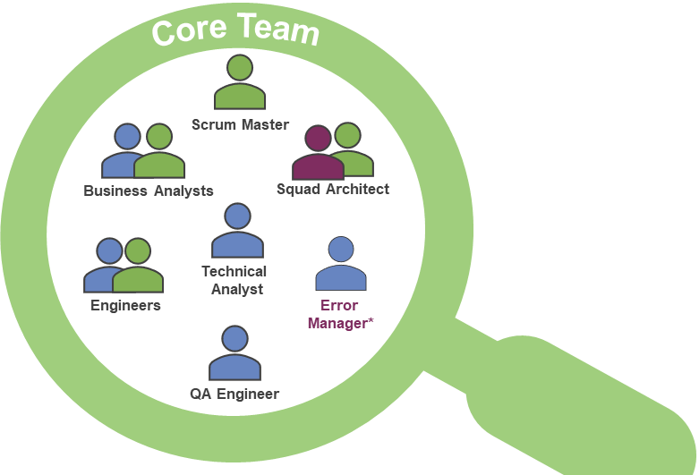
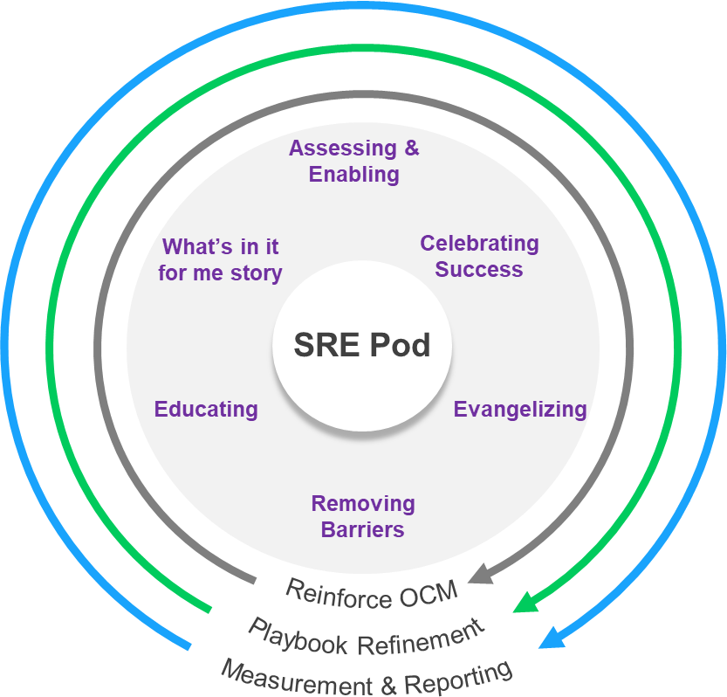
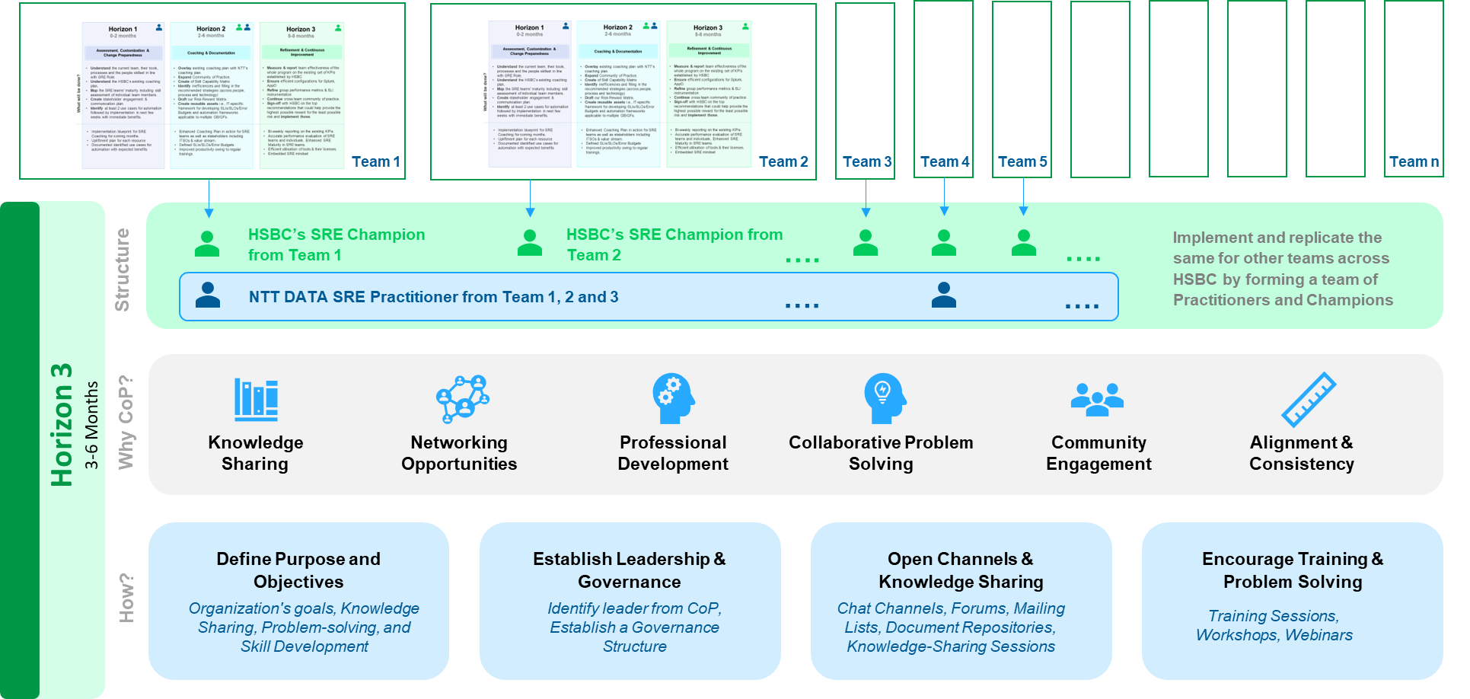

Our approach to build SRE maturity (People + Culture)
Assessment, Customization & Change Preparedness
What we have
What we need
Kick-off to set expectations
Comparative assessment of all 3 teams to understand what is working for them & identify gaps
Customer’s SRE Framework & Training Modules
Ways of Collaboration
Decision Making
Guiding principles
Agree on success metrics to be tracked
Baseline the selected metrics
How was this rolled out? – Trainings, reinforcement activities
What were the prior roles / skill sets of the members - skill maturity at start vs now
What inefficiencies were taken off the table right away?
What additional training is available for skill gaps?
What aids cross-team collaboration? Are there SRE-specific values, rituals followed?
Who are the identified SRE leaders to become SRE champions?
Who are the stakeholders outside of the teams and their degree of involvement?
Pre-requisites
Customer’s baseline metrics & KPIs
Identify 2 target teams for SRE maturity upliftment, one “control” team
Week 1 to Week 6
Key Considerations
Horizon 1
Lessons learnt from WPB ACS and Wholesale GPS
Mission Critical Apps
2 Target Teams
1 Control Team
(Role Model SRE Team)
Different Geographies
Different GB GFs
Develop POVs & Roadmap
What we “know”
What needs to be done
Why, When and How it needs to be done
Receive, Discuss, & Refine
Refinement & Continuous Improvement
Execution
Socialize POVs
(Show & Tell)
Refined Playbook
Customer SRE Champions leading SRE Maturity
Implement POVs
Wider Customer
Week 13 to Week 24
Week 6 to Week 12
Templates for assessments
Implementation steps
Use Cases for automation
Ideal team structures
Training modules
Communication plan
Horizon 3
Horizon 2
Community of Practice to ensure continuity & scale
SRE Embedded
Reinforcement & Continuous Improvement in progress
Refined Playbook
© 2024 NTT DATA, Inc.

Slide 38

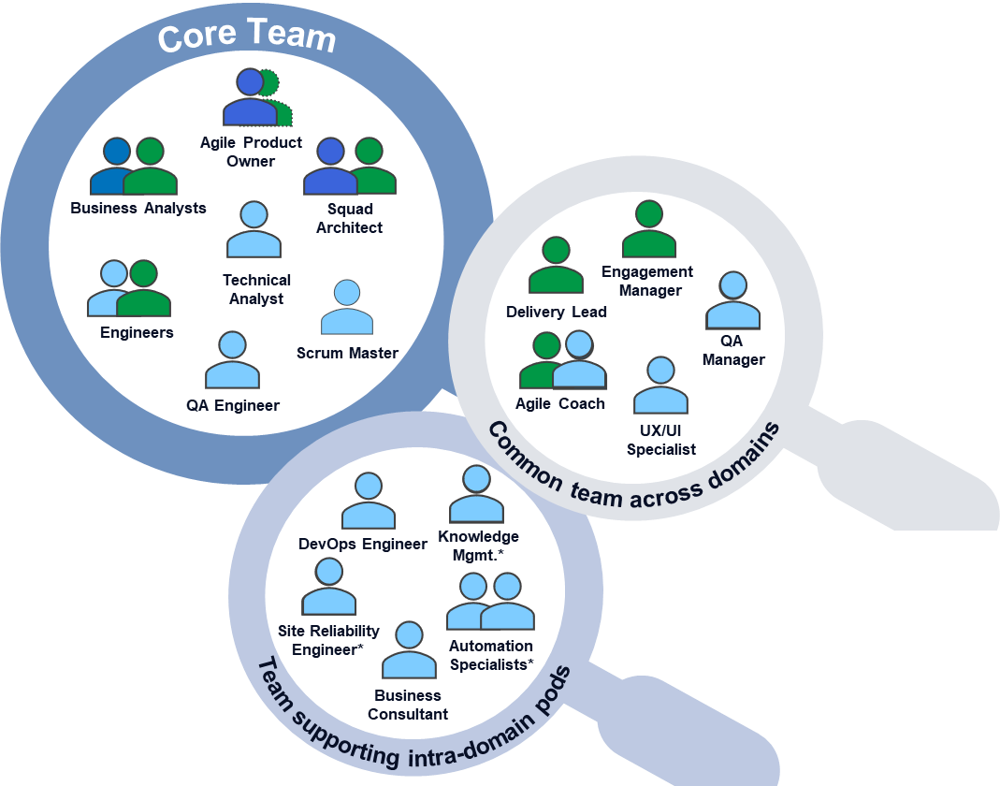
SRE & Org. Change Management Approach
Horizon 1
4-6 weeks
How was this rolled out? – Trainings, Reinforcement activities
What were the prior roles / skill sets of the members- Skill maturity for SRE at start vs now
What inefficiencies can we take off the table right away?
What additional training is available for skill gaps
What aids cross-team collaboration? - Are there SRE-specific values, rituals, behaviours followed?
Who are the natural SRE leaders who have the right mindset and willingness to coach and support others?
Who are the stakeholders outside of the teams and their degree of involvement?
Assessment, Customization & Change Preparedness
Horizon 1
4-6 Weeks
Identify
Assessment
Gather and Synthesize
2 Target Teams
1 Control Team
(Role Model e.g., Cyber Team)
Understand the current team, their tools, processes and the people skillset in line with SRE Role.
Understand HSBC’s existing coaching/training plan. Overlay existing coaching plan with NTT’s coaching plan.
Map the SRE teams' maturity including skill assessment of individual team members.
Baseline existing SRE maturity to the current TRMF ratings for all services managed by the SRE team.
Identify at least 2 automation use cases followed by implementation in few weeks.
Multiple teams working in HSBC
Key Considerations
Mission Critical Teams
Different Geographies
Different Focus Areas
Assessment to build out from the base of the SRE maturity model
What will be done?
Begin the Culture Change process with team members (evangelize)
Start the assessment of SRE individual capability – document outcomes and communicate initial assessment with HSBC leadership (current framework knowledge)
Baseline existing SRE maturity to the current TRMF ratings for all services managed by the SRE team.
Identify candidates for internal coaches
Develop learning paths for SRE team members based on the outcome of the capability assessment
Conduct individual and if possible, group reinforcement of process and concept of SRE (e.g. SLO, SLI, error budget, toil reduction, blameless post-mortem etc.)
Continue reinforcing the “Why is this good for me” story
Continue assessment of individuals, post reinforcement. Document and communicate.
Determine product landscape of target teams
Begin evangelizing program value to product owner
Assess skills against the target tools and technology stack
Conduct coaching sessions on skills to partner with developers and the mutual benefit of this relationship
Conduct automation workshops with target teams
Implement initial community of practice rituals for initial teams. Solicit community of practice volunteers to evangelize and plan community of practice events and communications.
Provide OCM coaching to community of practice volunteers
Assess the capability of team members to develop automation
Facilitate identification of toil within the target environments/ processes
Coach (show & tell) implementing several automation efforts to reduce toil identified in previous step (2) use cases
Begin theoretical discussions on SLO/ SLI/ Error Budget
Celebrate successes with candidate teams & present the goals for Horizon Two
Document lessons learned and formulate recommendations to executive sponsors
Develop POVs
Roadmap for SRE Coaching and Implementation.
Skill Assessment Matrix in line with required SRE roles and responsibilities.
Document identified use cases for automation with expected benefits.
Intended Outcomes
What we “know”
What needs to be done
Why, When and How it needs to be done
© 2024 NTT DATA, Inc.

